Slide 1
Risk Analysis – Banking, Financial Services and Insurance

Slide 2
Agenda
Introduction
Data Overview
Data Cleaning and Pre – processing steps
Exploratory Data Analysis
Dashboards from Power BI
Predictive Modelling
Image source: icons8`

Slide 3
Introduction
Business Objective :
The objective of this project is to modernize Prudential’s life insurance application process by leveraging predictive modeling to streamline risk classification. By automating the assessment of applicant risk levels, the model eliminates the need for traditional, time-consuming methods, reducing processing time from 30 days to just minutes. This innovation aims to enhance customer experience, making the application process faster and more accessible.
Additionally, the project seeks to improve operational efficiency and cost-effectiveness, allowing Prudential to allocate resources more strategically. By addressing the low adoption rate of life insurance in U.S. households (currently 40%), this solution positions Prudential as an industry leader in innovation, driving higher customer acquisition and revenue growth while maintaining privacy and compliance standards.
Image source: icons8`

Slide 4
Data Overview
Tables :
train.csv Table
Columns | 128
Entries / rows | 59381
Contains information of life insurance applicants, including demographics (age, height, weight, BMI), employment details, insurance history, family history, medical history, and keywords. Target variable "Response" indicates risk level (8 categories). Data includes categorical, continuous, discrete, and dummy variables.
test.csv Table
Columns | 127
Entries / rows | 19765
Similar to train.csv but without the "Response" column. Used for predicting risk levels.
Image source: icons8`

Slide 5
Observations made during Data Auditing:
Missing Data: Several columns have varying proportions of missing values, requiring imputation or removal strategies.
Imbalanced Target Variable: The Response column is skewed towards higher levels, and the modified response column shows a large rejection rate.
Outliers: Variables like BMI, Ht, and Wt exhibit outliers, which may need to be addressed to improve model performance.
Categorical Encoding: Many categorical variables (e.g., Product_Info_2, Employment_Info_2) require encoding for model readiness.
Feature Distributions: Continuous variables like Ins_Age, BMI, and Family_Hist follow diverse distributions, with some being skewed.
Variable Interactions: Relationships between features such as BMI, Ht, and Wt with risk categories highlight significant trends.
Correlation Analysis: Some features show multicollinearity, which could impact the interpretability of linear models.
High Dimensionality: The dataset has over 100 features, requiring dimensionality reduction or feature selection techniques.
Image source: icons8`

Slide 6
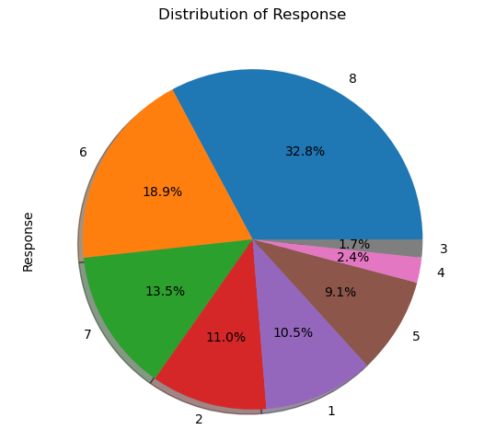
Distribution Of Target Variable
Insight :
The majority of applicants fall into higher response levels (8 – 33%, 6 – 19% and 7 – 14%), 65% indicating a higher likelihood of acceptance,
Lower Revels levels (3 – 2.4% and 4 – 1.7%), 4% are the least frequent/rejected.
Image source: icons8`

Slide 7

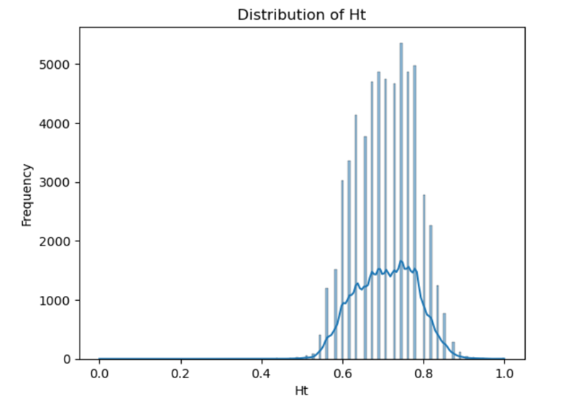
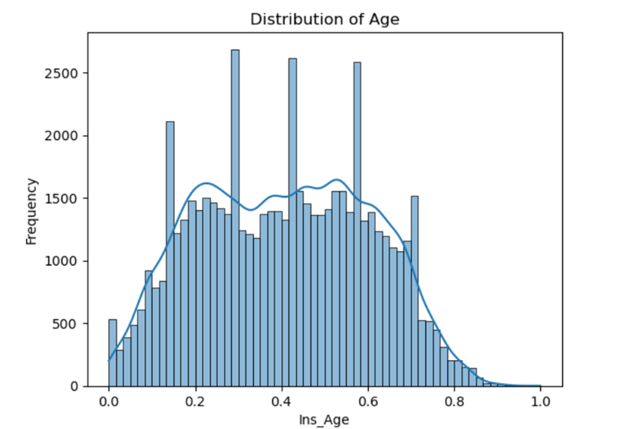
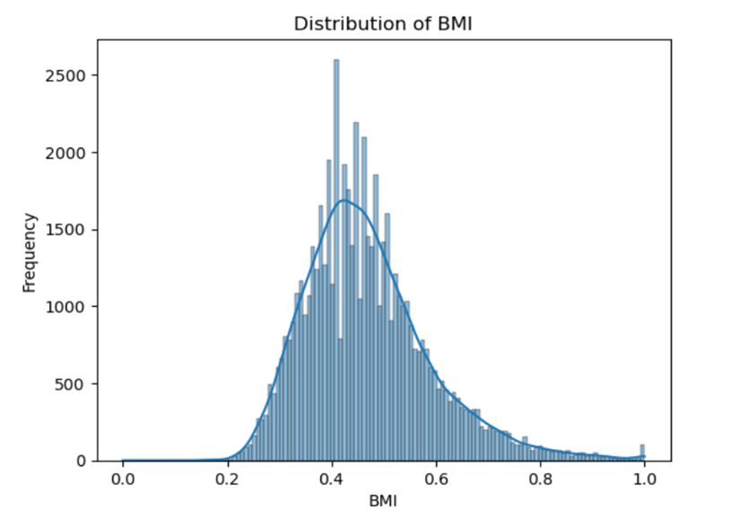
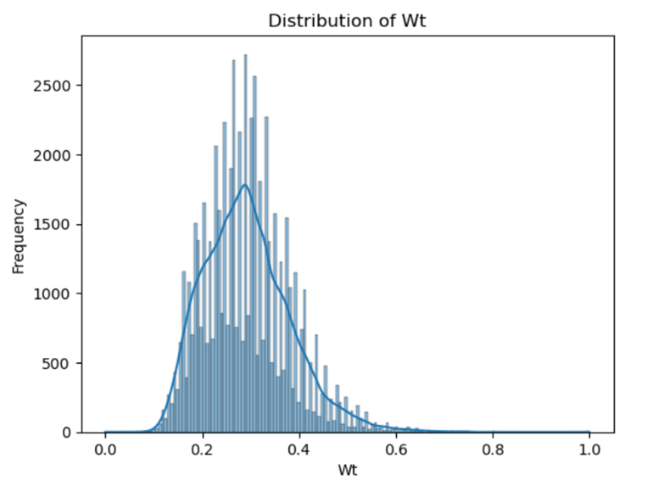
Distribution of Applicant's Physical Attributes
Image source: icons8`

Slide 8
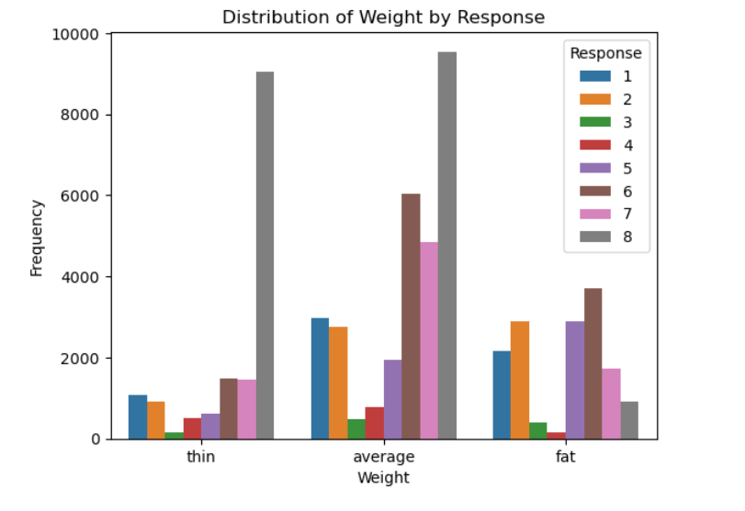
Distribution Of Applicant's Weight by Response
Insight :
Most responses are concentrated in the "average" weight category across all response types, especially for Category 8.
The "thin" group has fewer responses overall compared to "average" and "fat." categories 4 and 3 show the least activity.
The "fat" group shows notable responses, especially in Categories 6, 7, and 8.
Image source: icons8`

Slide 9
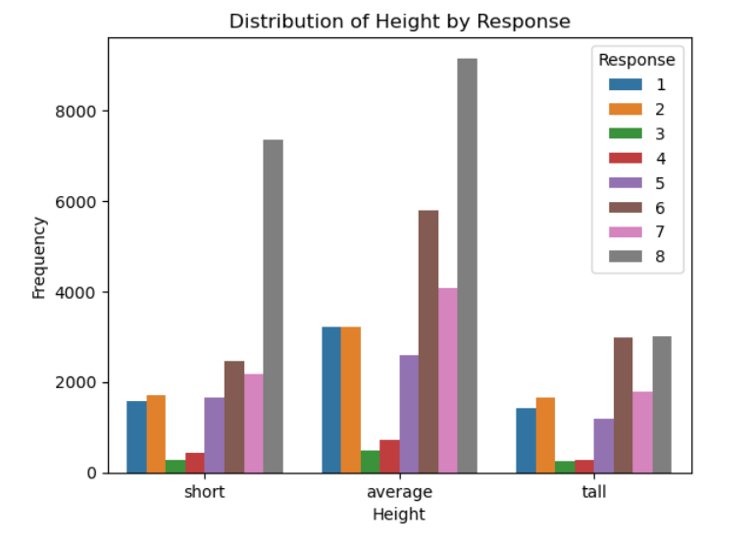
Distribution Of Applicant's Height by Response
Insight :
The "average" height group drives the majority of responses, with Categories 8, 6, and 7 being the most relevant.
"Short" and "tall" height groups show similar trends, though with fewer responses overall.
Categories 8 and 6 dominate across all height groups, showcasing their broad appeal.
Image source: icons8`

Slide 10
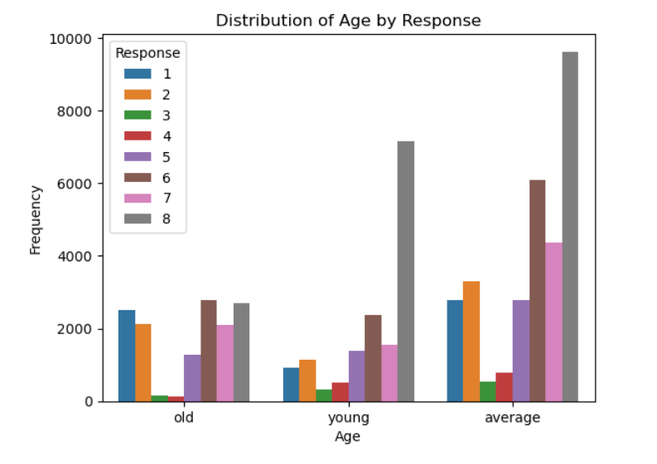
Distribution Of Applicant's Age by Response
Insight :
The "average" height group has the highest response count overall, particularly for response "8."
The "young" group consistently has the lowest frequencies across all response categories, indicating lower engagement.
Image source: icons8`

Slide 11
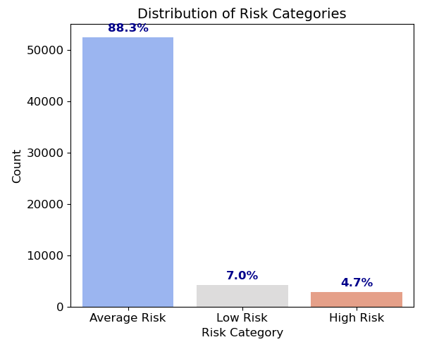
Risk Categorization of Applicants by BMI, Weight and Age
High Risk: Overweight, old, and fat individuals who are more likely to face health-related challenges.
Low Risk: Underweight, young, and thin individuals with reduced likelihood of high-risk classification.
Average Risk: Everyone else, exhibiting balanced health metrics without extremes in BMI, weight, and age.
Insight :
Majority (88.8%) in Average Risk: Indicates population stability but requires ongoing health monitoring.
Focus on High Risk (4.7%): Prioritize targeted interventions and preventive care for this small but critical group.
Low Risk (7.1%) offers an opportunity: Highlight favorable health attributes but monitor for potential risks as they age.
Image source: icons8`

Slide 12
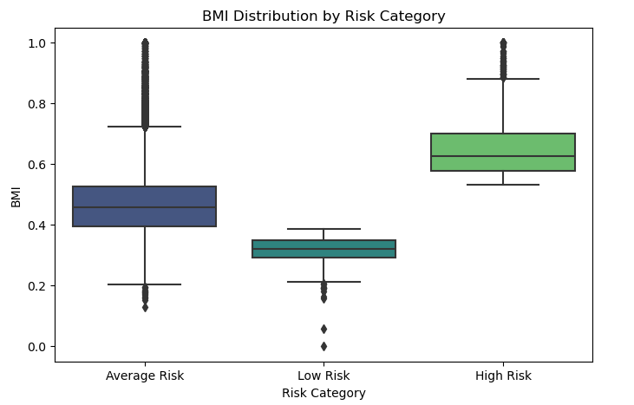
BMI Distribution by Risk Category
Average Risk:
BMI range is broad (0.11 to 1.00), reflecting diverse body types.
Majority group but varies widely, necessitating targeted health initiatives based on subgroups.
High Risk:
Narrow BMI spread (0.53 to 1.00), showing consistently high BMI among this group.
Requires immediate focus due to higher BMI values, associated with potential health complications.
Low Risk:
Limited BMI variability (0.00 to 0.38), consistent with underweight or optimal metrics.
Generally healthier but monitor for risks associated with being underweight.
Image source: icons8`

Slide 13
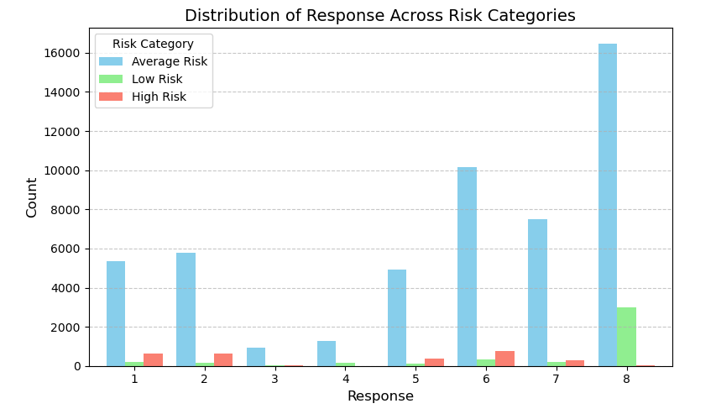
Distribution of Response across Risk Categorization
Image source: icons8`

Slide 14
Distribution of Response across Risk Categorization
Insight :
Average Risk:
Majority in this group fall into Response 8 (16,446, ~31.4%), followed by Response 6 (10,179, ~19.4%).
The least represented responses are 3 (947, ~1.8%) and 4 (1,275, ~2.4%).
Indicates a diverse distribution, with higher responses being more frequent.
Low Risk:
Dominated by Response 8 (3,009, ~72.2%), with small contributions from Response 1 (198, ~4.8%) and Response 6 (312, ~7.5%).
Minimal representation for Response 3 (34, ~0.8%) and Response 4 (149, ~3.6%).
Shows a clear skew toward low-risk favorable outcomes (higher response).
High Risk:
Concentrated in Responses 1 (646, ~23.1%), 2 (642, ~22.9%), and 6 (742, ~26.5%).
Very few in Responses 3, 4, and 8 (32, 4, and 34, collectively ~2.5%).
High Risk individuals have a more evenly distributed but concerning pattern with lower responses.
Image source: icons8`

Slide 15
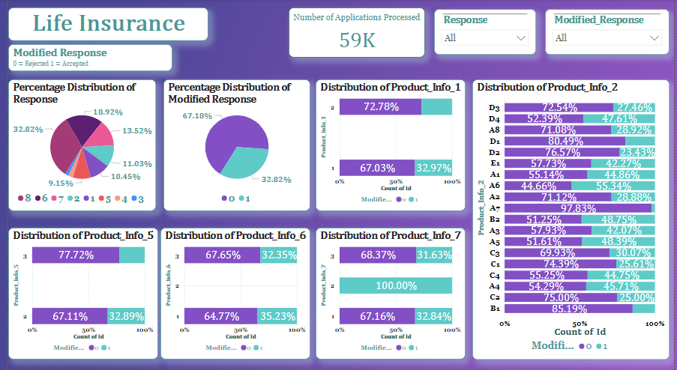
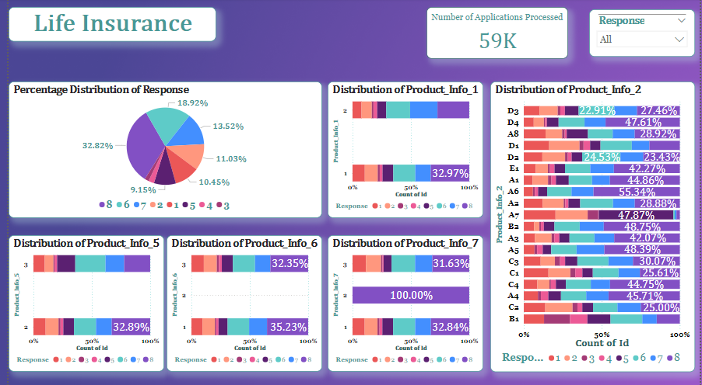

Slide 16
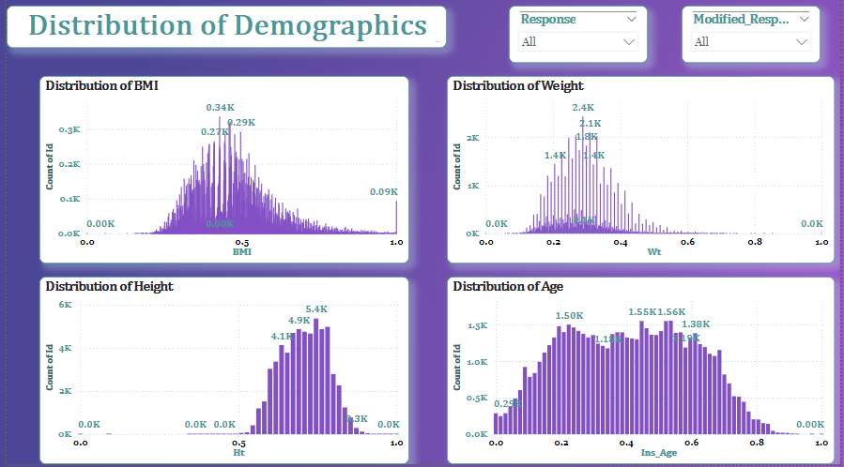

Slide 17

Predictive Modeling For Life Insurance
An Overview of Predictive Models and their Performance

Slide 18

Objective of the Analysis
Data Preprocessing and Feature Engineering
Model Development
Model Evaluation and Performance
Insights and Conclusions
Agenda

Slide 19

Purpose of the Analysis
Key Focus
Leverage machine learning techniques to improve the accuracy and reliability of predictions.
Goal
To develop predictive models that accurately identify response in the dataset.
Understand the most significant features influencing the prediction of response.
Build a range of models to compare performance, identify strengths, and determine the most effective approach for predicting response
Objective​

Slide 20

Data Preprocessing:
Feature Engineering:
Dimensionality Reduction:
Handling Imbalanced Data:
Algorithm Selection:
Models including Random Forest,Logistic Regression,SVM Algorithm and many more were chosen for their robustness, interpretability, and ability to handle high-dimensional data effectively.
Techniques like down-sampling and the application of class weights were considered to balance the dataset for fair model training.
PCA was used to reduce the feature space, improving computation speed while retaining significant variance in the data.
Domain knowledge and correlation analysis were applied to select the most relevant features, enhancing model accuracy.
The data was cleaned, missing values were handled, and outliers were treated to ensure a high-quality dataset.
Model Building Process

Slide 21
Data Preparation
Data Cleaning
Removing all the columns with more 10% of the missing values to improve the data quality an model performance.
Converted categorical features into numerical codes for compatibility with machine learning algorithms
Feature Scaling
Standardized the features using standardscaler to ensure each feature contributes equally to the model
Imputed or removed rows with missing values to ensure the completeness of dataset
Outlier Treatment
Identified and handled the outliers to reduce their impact on model accuracy and prediction
Categorical Encoding
Null Value Treatment

Slide 22
Commonly Used Algorithms for Classification
Interpretable results with coefficients indicating feature impact.
Effective for binary classification problems.
Disadvantages:
Assumes a linear relationship between features and the target variable.
Struggles with complex relationships and high-dimensional data.
Decision Trees
Advantages:
Easy to interpret and visualize.
Handles both numerical and categorical data.
Requires little data preprocessing.
Disadvantages:
Prone to overfitting, especially with deep trees.
Sensitive to small changes in data, leading to different splits.
Random Forest
Advantages:
Reduces overfitting by averaging multiple trees.
Handles high-dimensional data well.
Provides feature importance metrics.
Disadvantages:
Less interpretable compared to single decision trees.
Can be computationally intensive with large datasets.
Logistic Regression
Advantages:
Simple and easy to implement.
Support Vector Machines (SVM)
Advantages:
Effective in high-dimensional spaces.
Works well for both linear and non-linear classification using kernel functions.
Disadvantages:
Sensitive to the choice of kernel and regularization parameters.
Computationally expensive for large datasets.
K-Nearest Neighbors (KNN)
Advantages:
Simple and intuitive, easy to implement.
Non-parametric, making no assumptions about data distribution.
Disadvantages:
Computationally expensive during prediction, especially with large datasets.
Sensitive to irrelevant features and the scale of data.
Naive Bayes
Advantages:
Fast and efficient for large datasets.
Performs well with categorical features and in text classification.
Disadvantages:
Assumes independence among features, which may not hold in practice.
Less effective with small datasets.

Slide 23
Commonly Used Algorithms for Classification
Soft Voting Classifier
Advantages:
Class Confidence: Accounts for classifier confidence with probability weighting.
Works Well with Calibrated Models: Performs better when classifiers are well-calibrated.
Disadvantages:
Requires predict_proba(): Only works with classifiers that output probabilities.
Computationally Expensive: Needs to calculate probabilities for all classifiers.
Stacking Classifier
Advantages:
Better Generalization: Reduces overfitting by using a diverse set of models and combining them with a meta-model.
Flexible: Can work with any combination of models, including both classifiers and regressors.
Disadvantages:
Neural Network
Advantages:
High Accuracy: Especially effective in tasks like image recognition and natural language processing.
Disadvantages:
Computationally Expensive: Requires significant resources (GPUs, memory).
Requires Large Datasets: Needs substantial labeled data for effective training.
Better Accuracy: Uses probability estimates, leading to more refined predictions.
Risk of Misleading Predictions: Poorly calibrated models may skew results.
Improved Accuracy: Stacking often outperforms individual models by combining their strengths.
Complexity: More complex than other ensemble methods (e.g., bagging, boosting) because it requires training multiple models and a meta-model.
Computationally Expensive: Requires more resources and time due to training multiple models.
Overfitting Risk: If the base models are overfitted, the meta-model might also overfit, leading to poor performance on unseen data.
Automatic Feature Extraction: Eliminates the need for manual feature engineering.
Flexible: Can model complex, non-linear relationships.
Overfitting: Prone to overfitting if not properly regularized.

Slide 24

Model 1: Logistic Regression
Trained using all features to establish a baseline performance.
Model 2: Random Forest Classifier
Trained using all features to establish a baseline performance.
Model 3: Random Forest + Grid Search
Hyperparameters tuned using Grid Search to enhance model performance.
Model 4: Logistic Regression + Random Sampling
Focused on sampling down the data to provide the optimized performance
Model 5: Random Forest + Random Sampling
Model 6: Logistic Regression + PCA
Implemented a simplified model with PCA for better interpretability and classification performance.
Focused on sampling down the data to provide the optimized performance
Predictive Models Overview

Slide 25
Model 7: Random Forest + PCA
Implemented a simplified model with PCA for better interpretability and classification performance.
Model 8: Random Forest + Grid Search + PCA
Hyperparameters tuned using Grid Search to enhance model performance and with PCA for better interpretability and classification performance.
Model 9: Logistic Regression + Domain Knowledge
Reduced feature set chosen based on domain expertise for improved efficiency
Model 10: Random Forest + Random Sampling
Reduced feature set chosen based on domain expertise for improved efficiency
Model 11: Logistic Regression + VIF Factor
Model 12: Random Forest + VIF Factor
Focused on reducing the multicollinearity from the data to provide the optimized performance
Focused on reducing the multicollinearity from the data to provide the optimized performance
Predictive Models Overview

Slide 26
Model 13: Decision Tree Classifier
Trained using all features to establish a baseline performance.
Model 14: XG Boost
Trained using all features to establish a baseline performance.
Model 15: KNN Algorithm
Trained using all features to establish a baseline performance.
Model 16: SVM Algorithm
Trained using all features to establish a baseline performance.
Model 17 : Logistic With Smote
SMOTE helps Logistic Regression perform better on imbalanced datasets by generating synthetic minority class samples.
Model 18 : Random With Smote
SMOTE helps Random Forest Classifier perform better on imbalanced datasets by generating synthetic minority class samples.
Predictive Models Overview

Slide 27
Model 19 : SVM Algorithm With Smote
SMOTE helps SVM Algorithm perform better on imbalanced datasets by generating synthetic minority class samples.
Model 20 : XG-Boost With Smote
SMOTE helps XG-Boost perform better on imbalanced datasets by generating synthetic minority class samples.
Model 21 : Ensemble Voting Classifier
The Ensemble Voting Classifier combines multiple models, improving accuracy and robustness by leveraging the strengths of different classifiers.
Model 22 : Ensemble Stacking Classifier
The Ensemble Voting Classifier combines multiple models, improving accuracy and robustness by leveraging the strengths of different classifiers.
Model 23 : Artificial Neural Network
Artificial Neural Networks (ANNs) can model complex patterns and relationships in data, making them highly effective for tasks like image recognition and natural language processing.
Predictive Models Overview

Slide 28

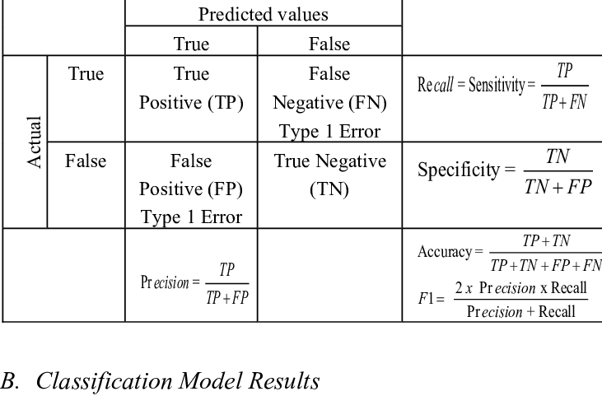
Accuracy:
Definition: The percentage of total predictions that were correct.
Example: If a model predicts 90 out of 100 applicants correctly (whether they will default or not), the accuracy is 90%.
Precision:
Definition: The proportion of true positive predictions among all positive predictions (i.e., correctly identified defaulters).
Example: If the model predicts 40 applicants as defaulters, but only 30 actually defaulted, precision is 75% (30/40).
Recall (Sensitivity):
Definition: The proportion of true positive predictions among all actual positives (i.e., all actual defaulters).
Example: If there are 50 actual defaulters and the model correctly identifies 30 of them, recall is 60% (30/50).
F1 Score:
Definition: The harmonic mean of precision and recall, providing a balance between the two metrics.
Example: For a precision of 75% and recall of 60%, the F1 Score is about 66.67%.
Support:
Definition: The number of actual occurrences of the positive class (i.e., actual defaulters) in the dataset.
Example: If there are 100 actual defaulters in the dataset, the support for this class is 100.
Model Evaluation Metrics

Slide 29
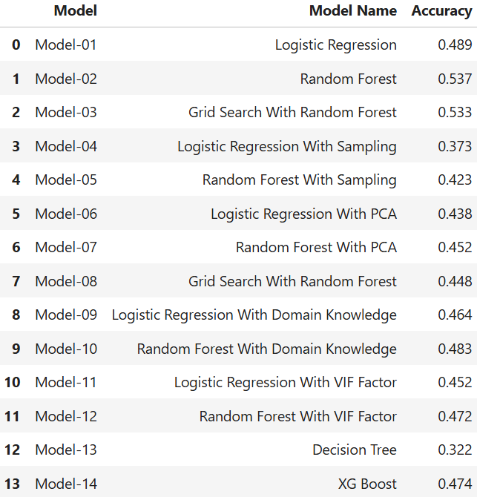
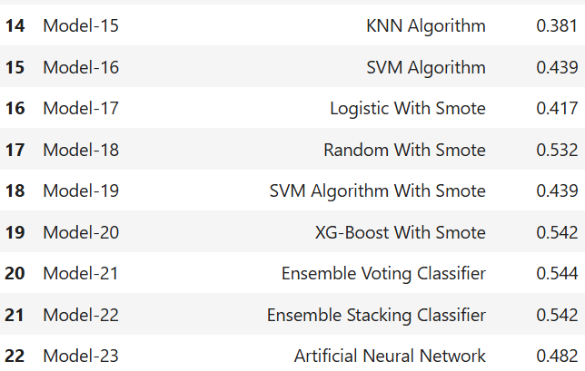
Model Evaluation Comparison Summary
Model-21 (Ensemble Voting Classifier)
Highest accuracy overall.
Strong performance with Logistic , KNN-Boost & Random Forest
Accuracy: 0.544

Slide 30
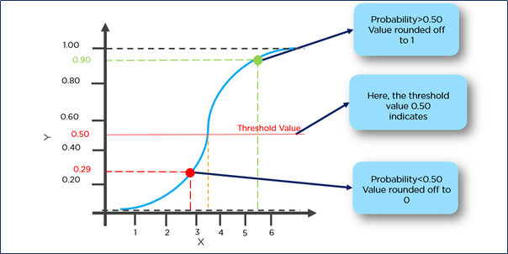
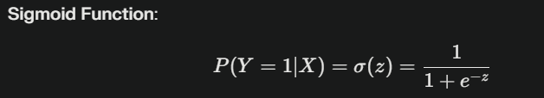

Mathematical Equation of the Logistic Model:​

Slide 31
Mathematical Equation of the Logistic Model:​
​y=(−0.12038187×Product_Info_1)+(0.01431836×Product_Info_2)+(−0.03157956×Product_Info_3)+(0.24720846×Product_Info_4)+(−0.06241614×Product_Info_5)+(−0.02991516×Product_Info_6)+(0.00164559×Product_Info_7)+(−0.08863941×Ins_Age)+(0.59801962×Ht)+(−1.23425547×Wt)+(−0.33661391×BMI)+(0.04330132×Employment_Info_1)+(−0.01689218×Employment_Info_2)+(−0.05334298×Employment_Info_3)+(0.02513422×Employment_Info_5)+(−0.07844689×InsuredInfo_1)+(−0.33470217×InsuredInfo_2)+(−0.01347162×InsuredInfo_3)+(0.04720176×InsuredInfo_4)+(−0.09704302×InsuredInfo_5)+(0.19908463×InsuredInfo_6)+(−0.11903446×Insurance_History_1)+(−0.15304081×Insurance_History_2)+(−0.13396049×Insurance_History_4)+(0.06138787×Insurance_History_8)+(0.10022397×Insurance_History_9)+(−0.04764251×Family_Hist_1)+(0.13087188×Medical_History_2)+(0.04547348×Medical_History_3)+(0.08104182×Medical_History_4)+(0.59911215×Medical_History_5)+(−0.18302893×Medical_History_7)+(0.04217379×Medical_History_8)+(−0.01403278×Medical_History_9)+(−0.03691226×Medical_History_11)+(0.04916223×Medical_History_12)+(−0.02872885×Medical_History_13)+(0.01116973×Medical_History_14)+(0.04227552×Medical_History_16)+(−0.00241858×Medical_History_17)+(0.09026067×Medical_History_18)+(−0.11171071×Medical_History_19)+(−0.05426285×Medical_History_20)+(0.13719706×Medical_History_21)+(−0.00070575×Medical_History_22)+(0.01200596×Medical_History_26)+(−0.04434327×Medical_History_27)+(0.04153879×Medical_History_28)+(−0.00440305×Medical_History_29)+(0.05497028×Medical_History_30)+(−0.37114664×Medical_History_31)+(0.07712412×Medical_History_33)+(0.19499159×Medical_History_34)+(−0.00642266×Medical_History_35)+(−0.06752685×Medical_History_36)+(−0.02234279×Medical_History_38)+(−0.04129258×Medical_History_39)+(0.14879697×Medical_History_40)+(0.19775369×Medical_History_41)+(0.0318461×Medical_History_42)+(−0.00762004×Medical_History_43)+(0.00597669×Medical_History_44)+(−0.7022005×Medical_History_45)+(−0.0478478×Medical_History_46)+(0.00916181×Medical_History_47)+(0.05458753×Medical_Keyword_1)+(0.01930799×Medical_Keyword_2)+

Slide 32
Mathematical Equation of the Logistic Model:​
​+(0.00869921×Medical_Keyword_3)+(−0.03787455×Medical_Keyword_4)+(0.02654035×Medical_Keyword_5)+(−0.00239261×Medical_Keyword_6)+(−0.0116488×Medical_Keyword_7)+(−0.00605247×Medical_Keyword_8)+(0.01509313×Medical_Keyword_9)+(−1.16802234×Medical_Keyword_10)+(0.00568268×Medical_Keyword_11)+(−0.00583242×Medical_Keyword_12)+(−0.02144577×Medical_Keyword_13)+(0.0265126×Medical_Keyword_14)+(0.00800486×Medical_Keyword_15)+(−0.00657718×Medical_Keyword_16)+(0.06181554×Medical_Keyword_17)+(0.09267521×Medical_Keyword_18)+(−0.01499836×Medical_Keyword_19)+(−0.00411056×Medical_Keyword_20)+(0.01839919×Medical_Keyword_21)+(−0.00545927×Medical_Keyword_22)+(0.00274933×Medical_Keyword_23)+(0.0202754×Medical_Keyword_24)+(0.04895528×Medical_Keyword_25)+(−0.04912048×Medical_Keyword_26)+(0.02818811×Medical_Keyword_27)+(−0.01058648×Medical_Keyword_28)+(0.03078913×Medical_Keyword_29)+(−0.23930928×Medical_Keyword_30)+(−0.04313431×Medical_Keyword_31)+(0.01082219×Medical_Keyword_32)+(−0.30258715×Medical_Keyword_33)+(0.02451717×Medical_Keyword_34)+(−0.0284467×Medical_Keyword_35)+(0.18099447×Medical_Keyword_36)+(−0.02415442×Medical_Keyword_37)+(0.07834315×Medical_Keyword_38)+(0.00775607×Medical_Keyword_39)+(0.04170285×Medical_Keyword_40)+(−0.02153335×Medical_Keyword_41)+(−0.05837546×Medical_Keyword_42)+(−0.01866253×Medical_Keyword_43)+(0.04676372×Medical_Keyword_44)+(−0.01592919×Medical_Keyword_45)+(−0.05147264×Medical_Keyword_46)+(0.01431371×Medical_Keyword_47)+0.33465976

Slide 33
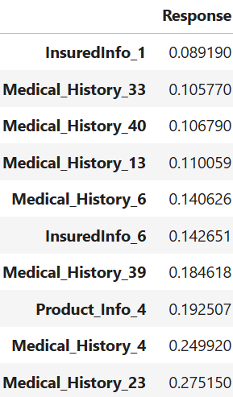
Top Positive Influences:
Higher values in these features increase the predicted likelihood of default.
--------feature & coefficient values + explanation of each

Slide 34
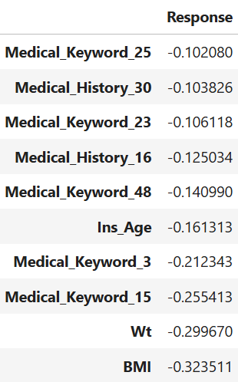
Top Negative Influences:
In these cases, higher values generally indicate financial stability, resulting in a lower likelihood of default.

Slide 35
Thank you!

